Slide 1


Slide 2
Project Title Predictive Modelling for Insurance Claim Probability Based on Comprehensive Car Policy Features and Safety Ratings present by G srimanth

Slide 3
Problem Statement Develop a predictive model that assesses the claim probability for car insurance policies. The objective would be to understand the factors that influence claim frequency and severity in the period of six months and enable insurance companies to better assess risk and determine appropriate premiums for policyholders.

Slide 4
Agenda
INTRODUCTION 1
DATA OVERVIEW 2
DATA CLEANING 3
EXPLORATORY DATA ANALYSIS(EDA) 4
METHODOLOGY 6
MODEL PERFORMANCE 7
KEY INSIGHTS AND FINDINGS 8
CONCLUSION 9

Slide 5
INTRODUCTION Intro: This project focuses on leveraging data science techniques to build a predictive model for insurance claim probability using comprehensive car policy features and safety ratings. Objective: The objective would be to understand the factors that influence claim frequency and severity in the period of six months and enable insurance companies to better assess risk and determine appropriate premiums for policyholders

Slide 6
DATA OVERVIEW
DATA SHAPE: NUMBER OF COLUMNS: 44 NUMBER OF ROWS: 58592 DATA TYPES: FLOAT: 4 INTEGER: 12 OBJECT: 28
TARGET VARIABLE:
IS_CLAIM
NO DUPLICATED VALUES

Slide 7
DATA CLEANING
1) NO MISSING VALUES.
2) OUTLIER TREATED BY USING CAPPING METHOD
3) ENCODING 4) IMBALANCE TREATMENT
Technique : SMOTE
FEATURE NAMES
Age of car
Population Density
Age of policy holder

Slide 8
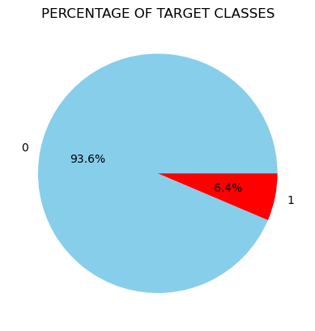
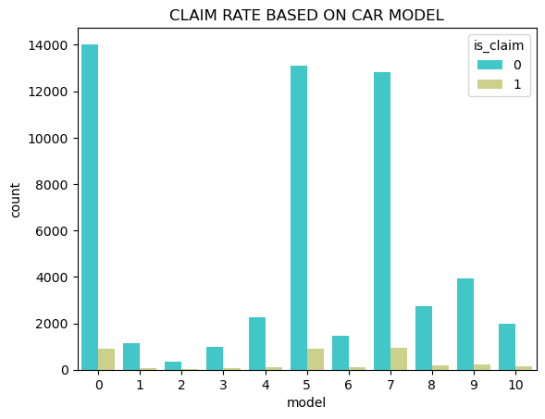
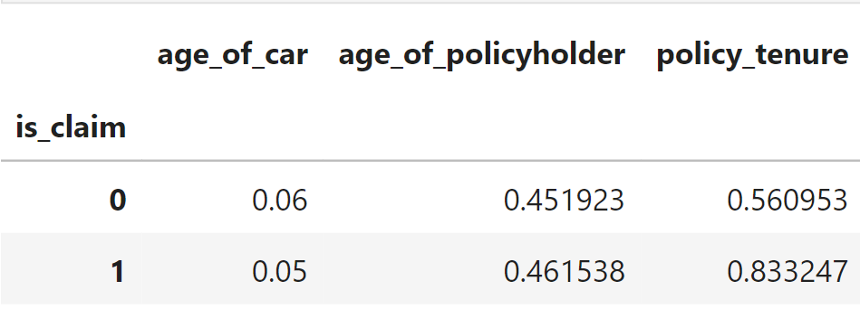
EXPLORATORY DATA ANALYSIS(EDA)

Slide 9
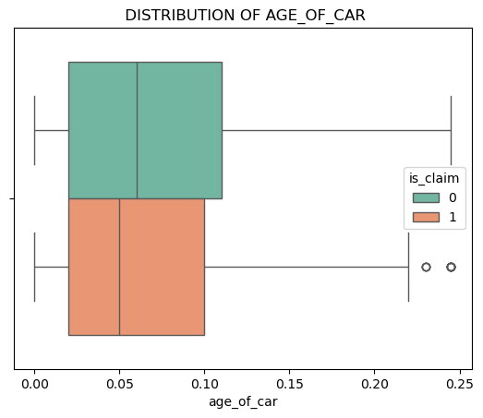
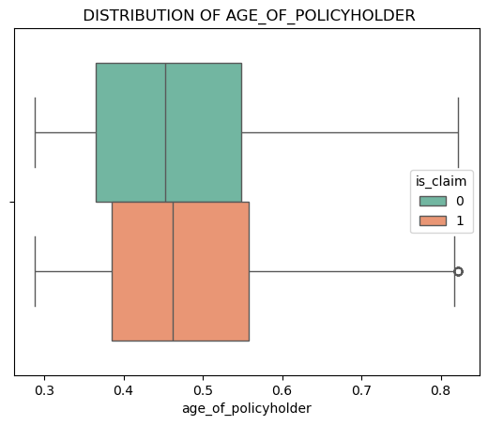
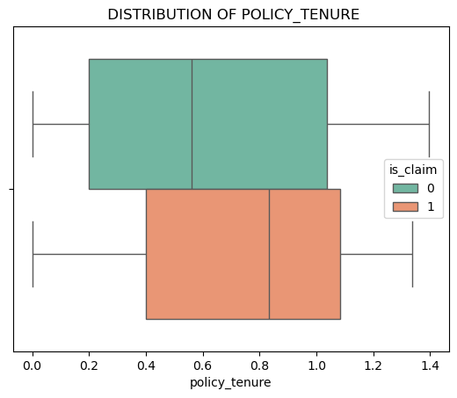

Slide 10
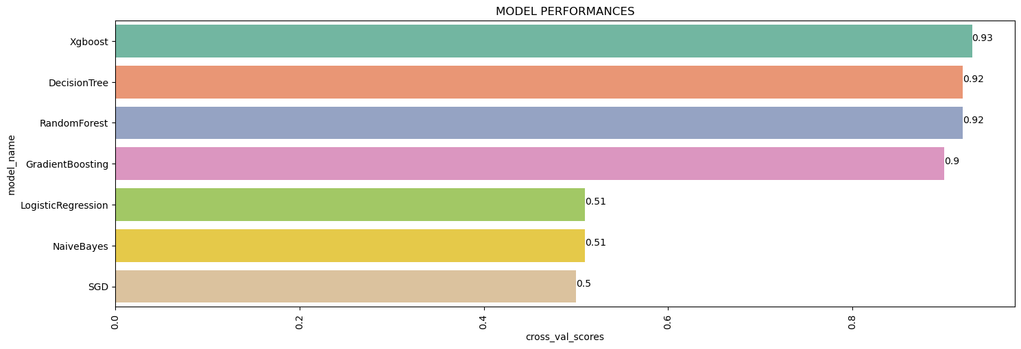
METHODOLOGY Feature Selection Techniques: Chi – square and ANOVA (To find weather predictors have relationship with target variable) Machine Learning Models: Naïve bayes, Logistic regression, Decision tree, Random Forest, GradientBoostingClassifier and XGBClassifier. Model Selection: XGBCLASSIFIER is chosen due to high score among the models.

Slide 11
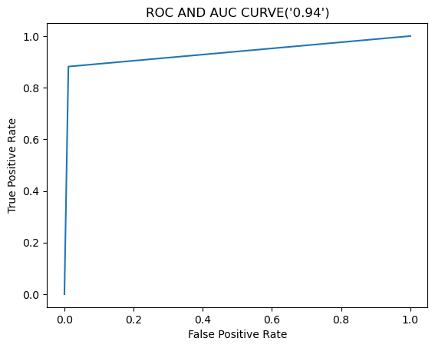
MODEL PERFORMANCE .
Model Name: XGBCLASSIFER
Accuracy: 93%
Precision: 94%
Recall: 94%
The model successfully identifies 93% of customers who will claim, allowing car insurance companies to take proactive measures.

Slide 12
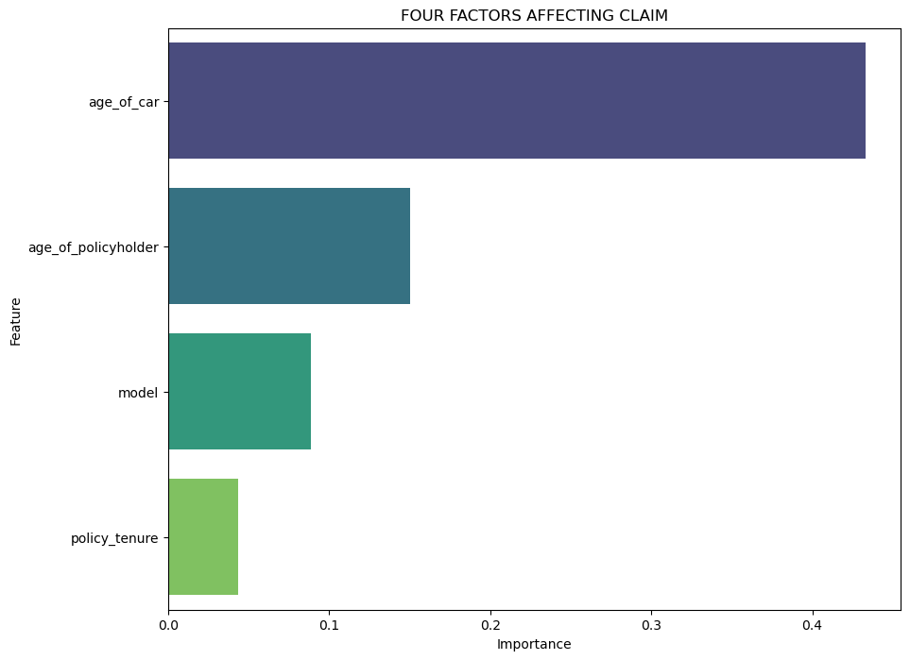
KEY INSIGHTS AND FINDINGS
AGE_OF_CAR:
Insight: Older cars might have higher claim rates due to wear and tear.
Finding: Investigate the relationship between car age and claim types (e.g., mechanical failures vs. accidents).
AGE_OF_POLICYHOLDER:
Insight: Different age groups may exhibit varying driving behaviors and risk levels.
Finding: Identify high-risk age groups for targeted risk management strategies.
MODEL:
Insight : Specific car models may have unique risk characteristics.
Finding : Compare claim data across different models to identify high-risk models.
POLICY_TENURE:
Insight : Longer policy tenure might correlate with customer loyalty and lower claim rates.(But there is also chance of high claim rates) .
Finding : Analyze trends in policy renewals and their impact on claim frequency.

Slide 13
CONCLUSION
Age of car, age of policy holder, Model of the car, policy tenure are critical predictors of car insurance claim
So set different premiums based on those predictors for policy holders to reduce risk and gain profit

Slide 14
Thank you
G srimanth
Srimanthsri9493@gmail.com

